Slide 1
“COMPANION” A CHOICE GAME
Team 1
By Hunter, Citlally, Nicki, and Jorge V.

Slide 2
DAY 1
In the morning, we finished out story and decided how we wanted our website to look. We also worked on the HTML and CSS
In the afternoon, the login page was updated and is coming together. The logic in the javascript for the story is 100% done as well

Slide 3
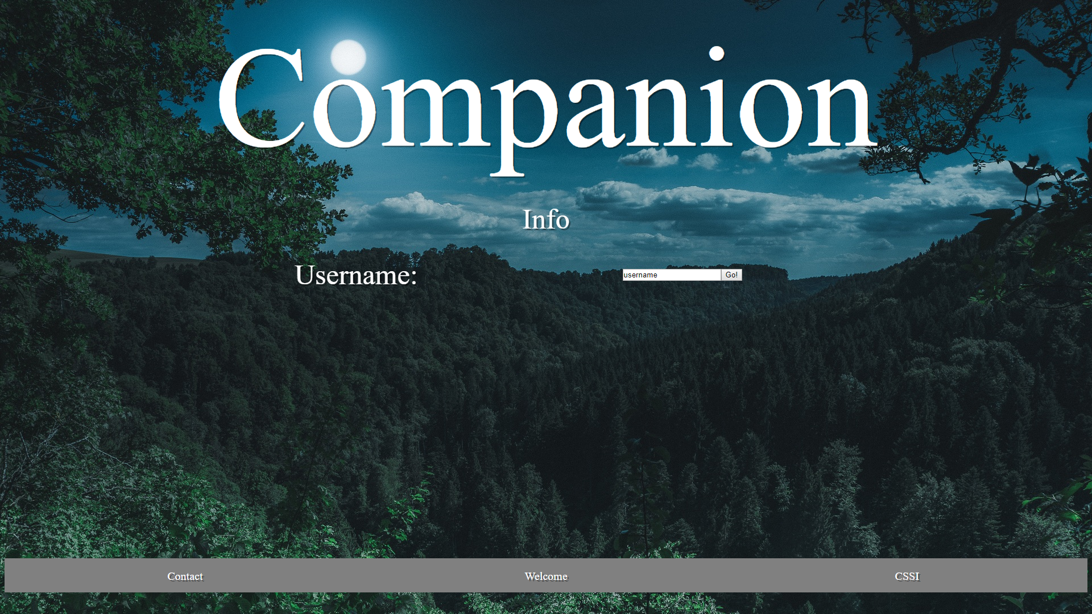

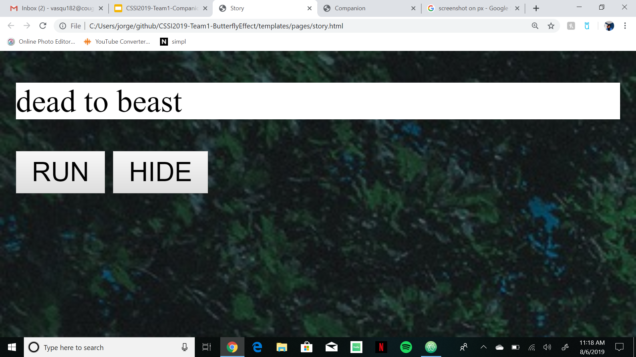

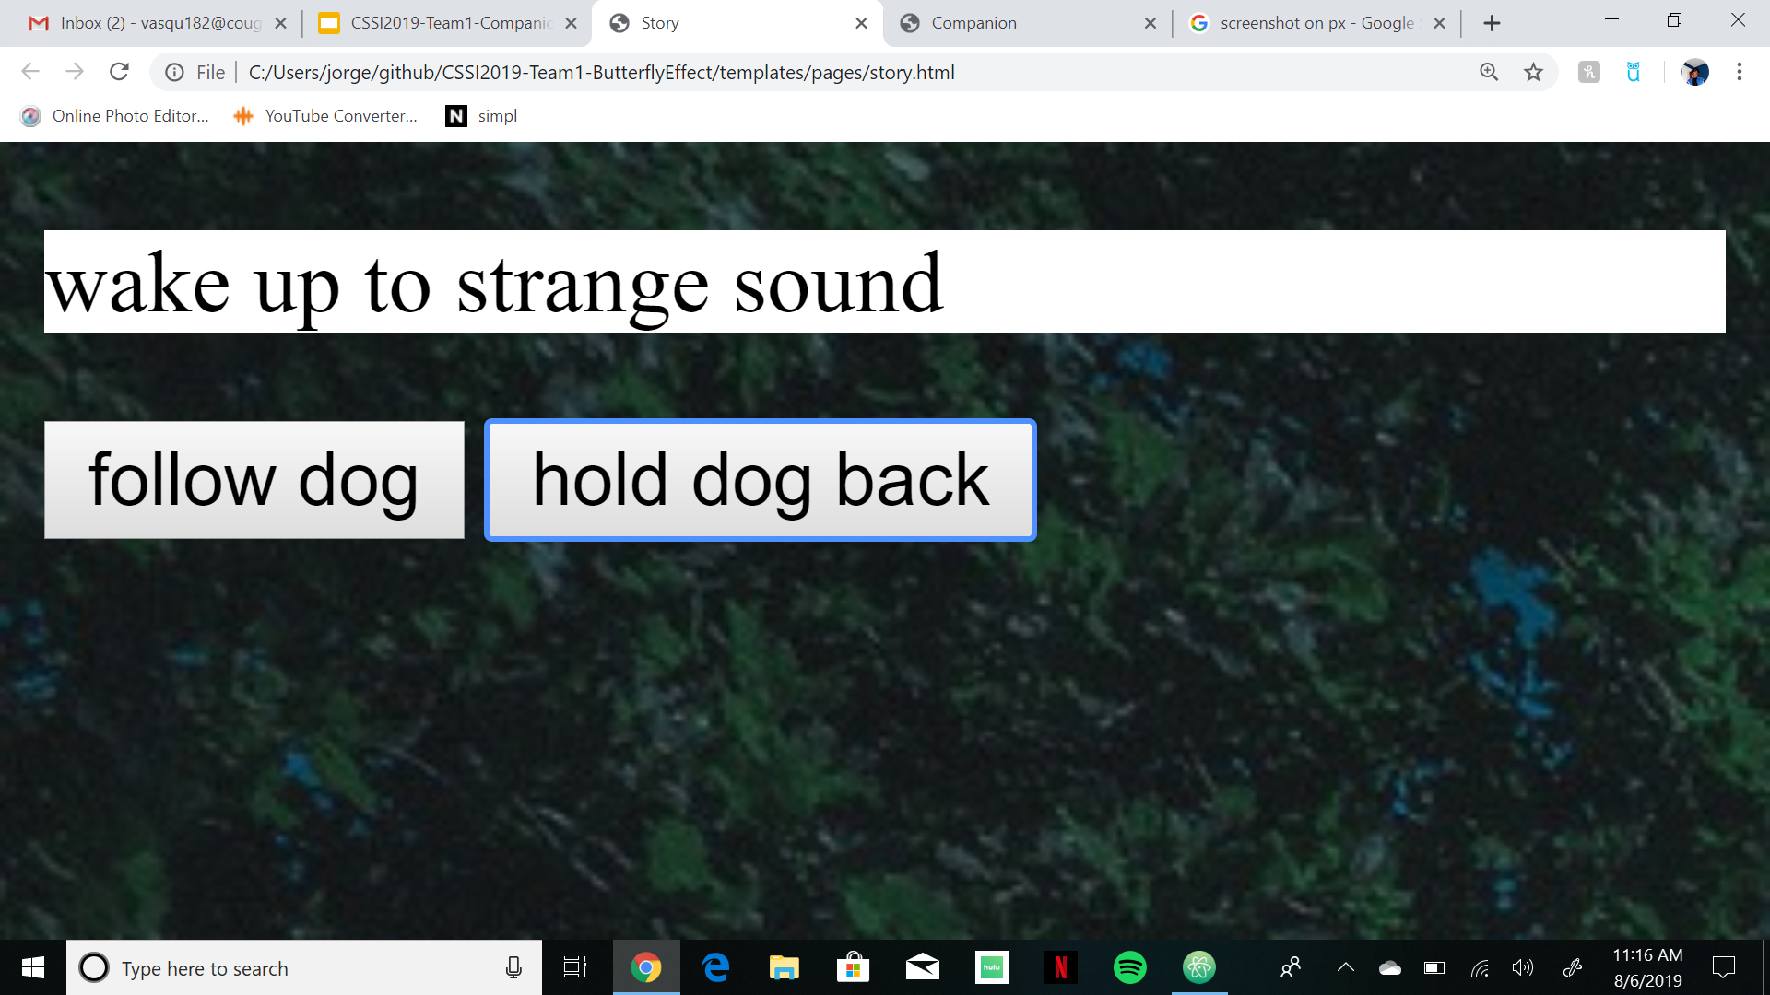
DAY 2
finished working on the whole story (linking all possible story paths)
Finished the homepage of the game
Work on the user login
BEAST ^

